Slide 1
Eksplorasi dan Visualisasi Data - 3SDT
WAHYONO KUNTOHADI
Kuliah Praktisi PENS, Semester Ganjil 2023

Slide 2
Pertemuan 2: TIME SERIES CHART Sustainable Development Goals (SDGs): ANALISIS TREN KEMISKINAN
September 27th, 2023

Slide 3

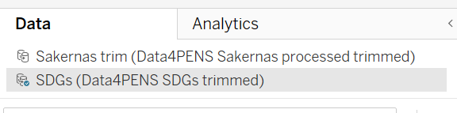
VISUALISASI TIME SERIES LINE CHARTs via WORKSHEETS

Slide 4
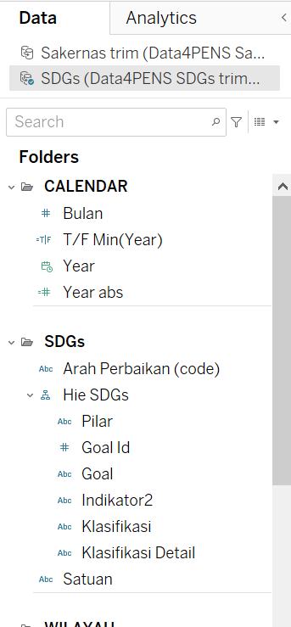
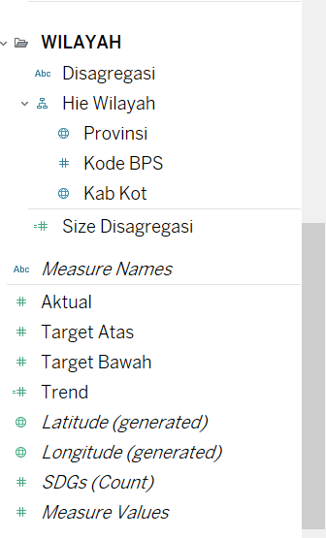
DATA SOURCE

Slide 5
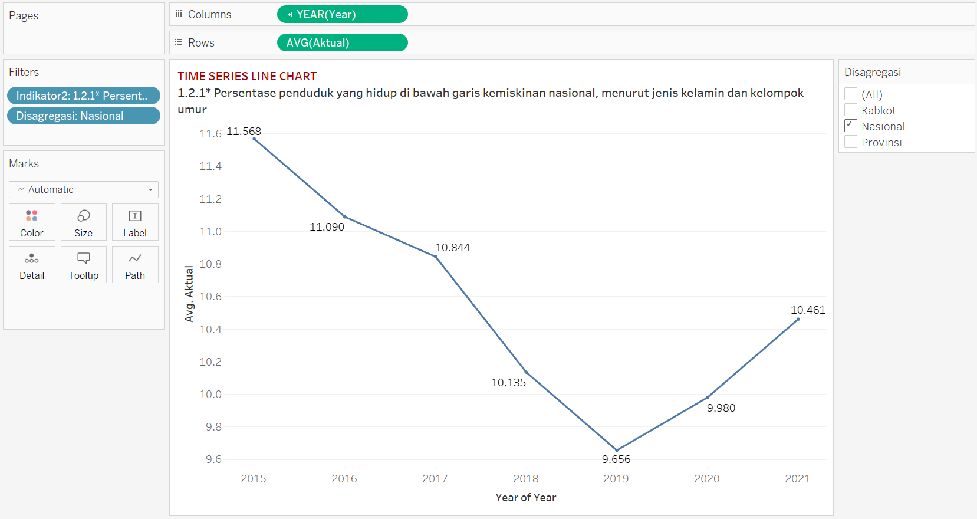
WORK 1 – LINE CHART TIME SERIES

Slide 6
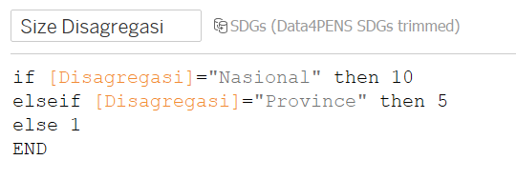
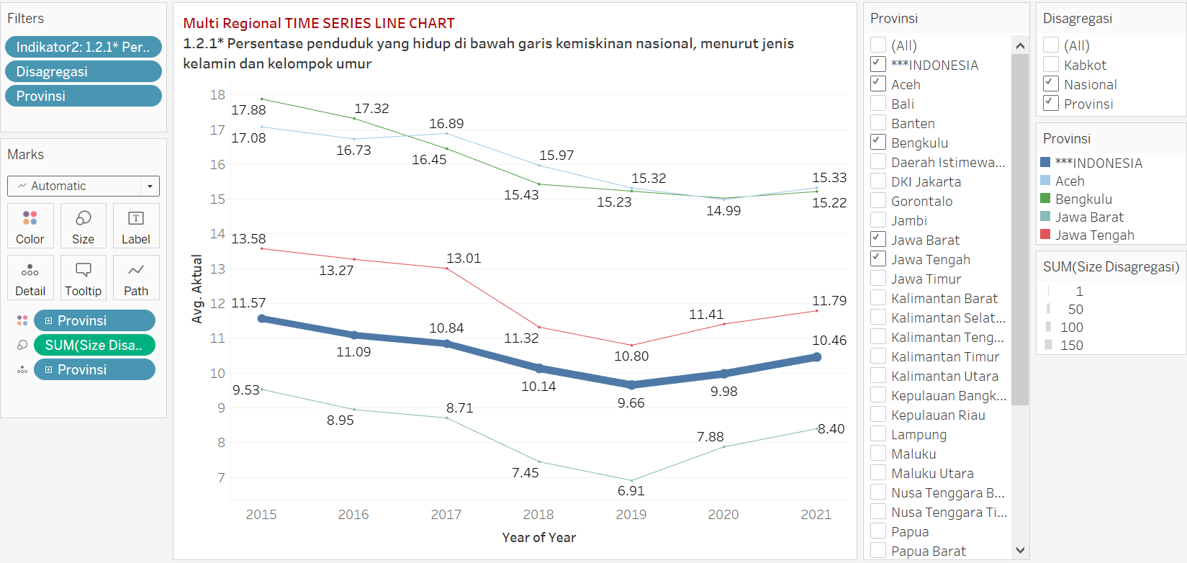
WORK 2 – Multi Regional TIME SERIES

Slide 7
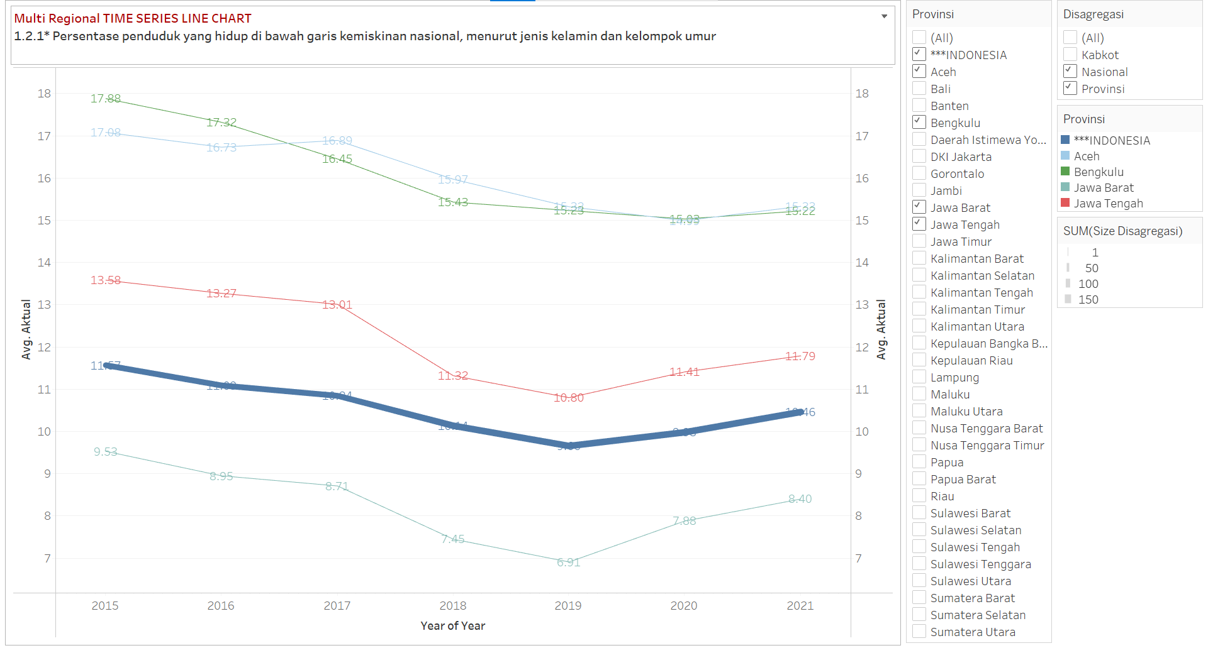
WORK 1 – (Dual Axis) Multi Regional TIME SERIES: TEST

Slide 8
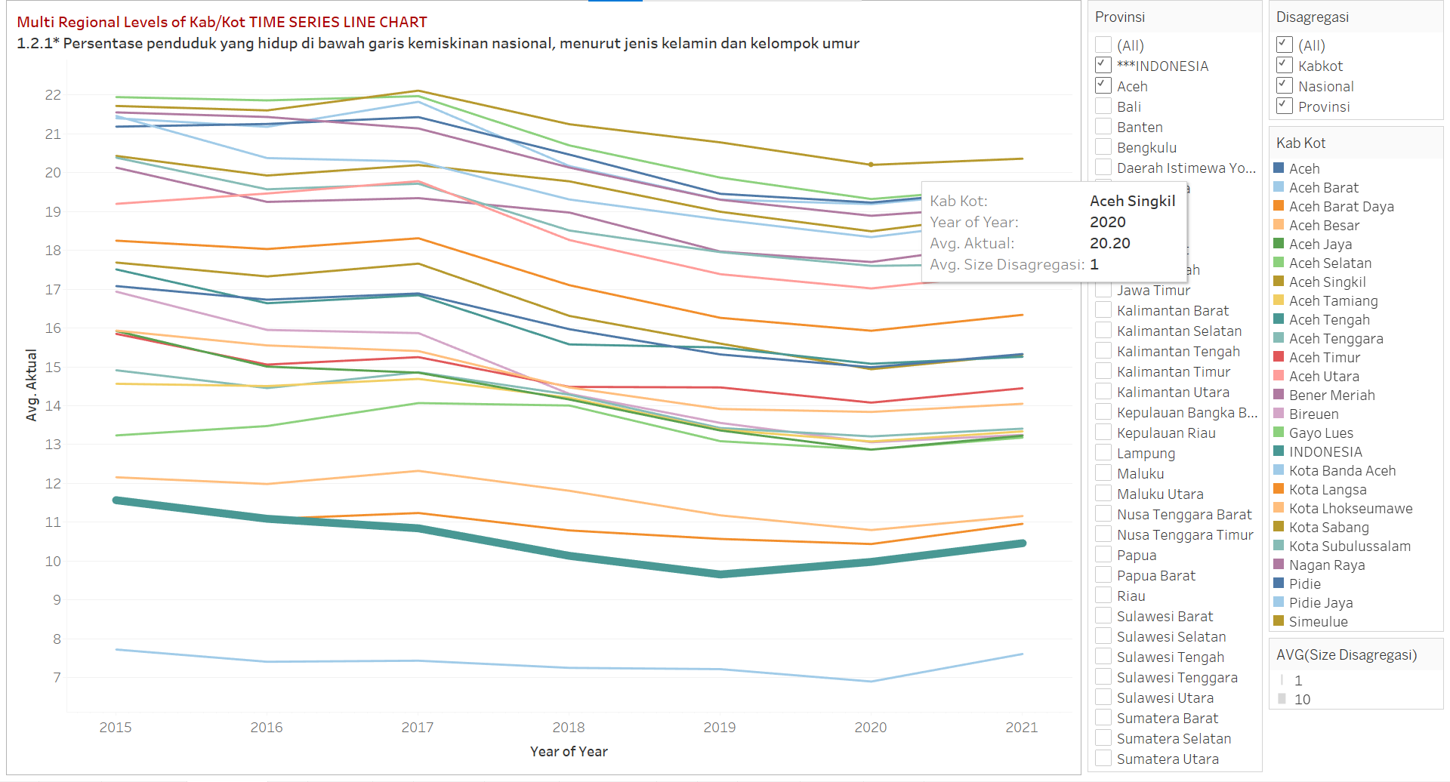
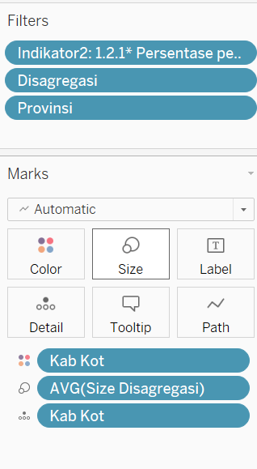
WORK 1 – Multi Regional Levels of KABKOT LINE CHART TIME SERIES

Slide 9
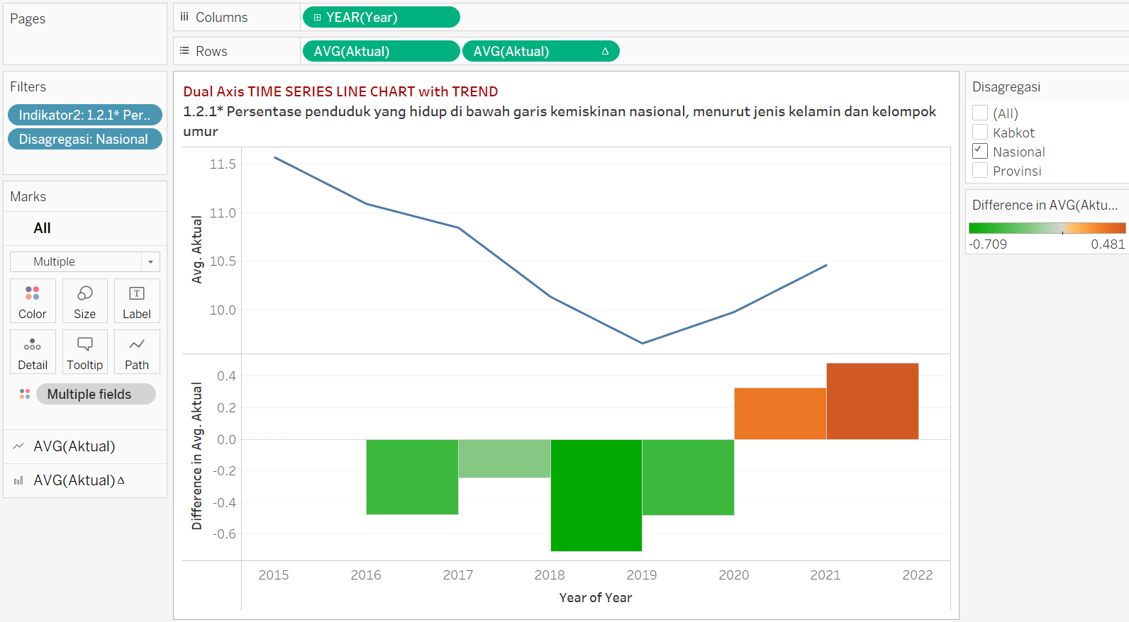
WORK 2 – PARALLEL GRAPH of TIME SERIES with TREND

Slide 10
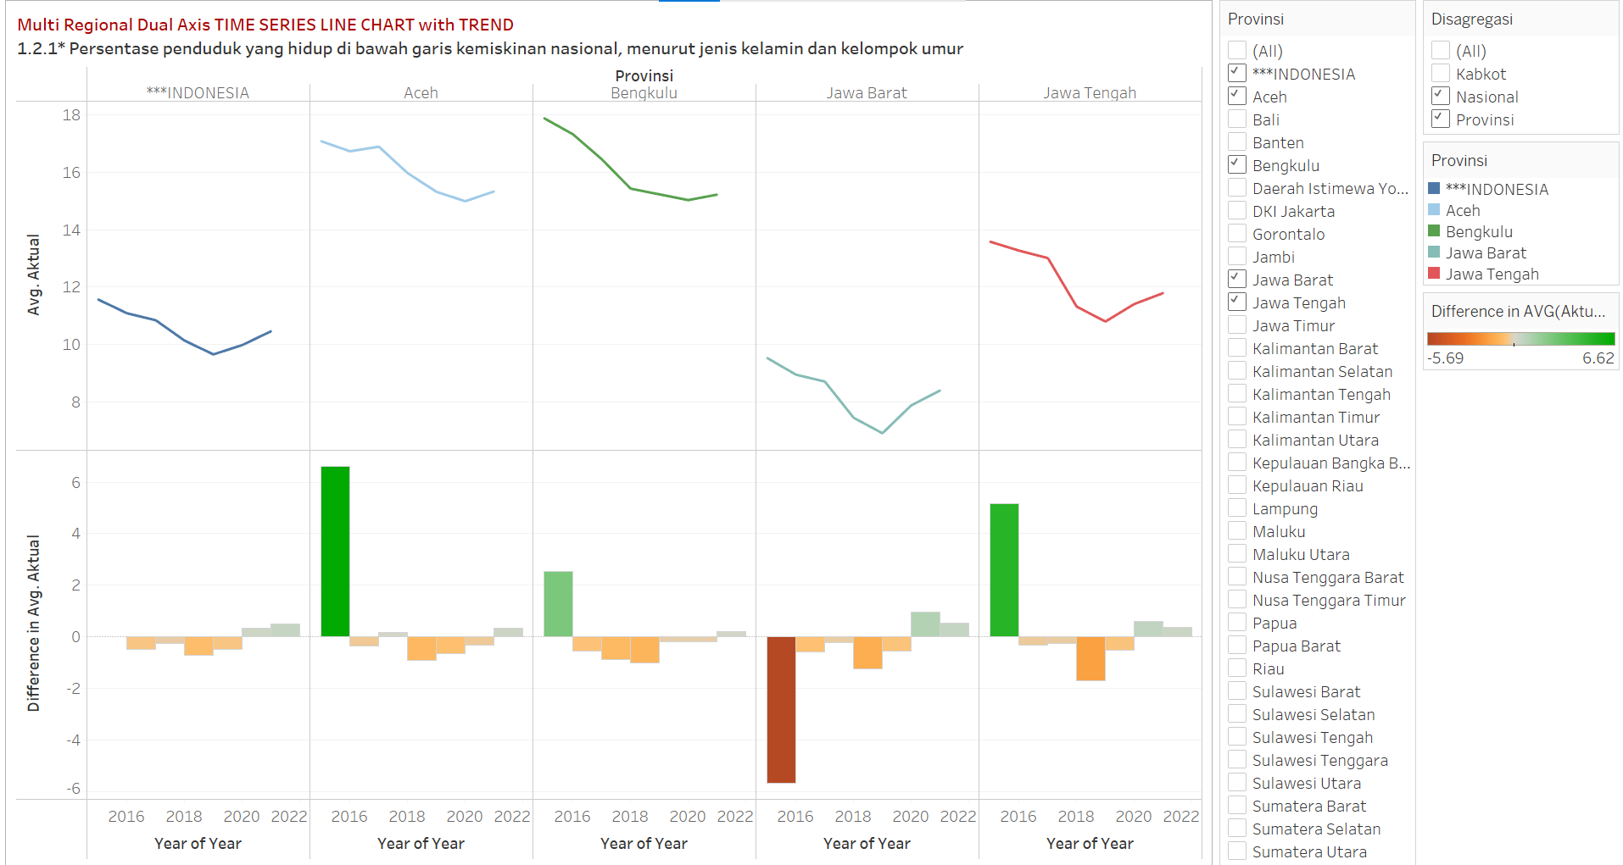
WORK 2 – Multi Regional PARALLEL GRAPH of TIME SERIES with TREND: TEST

Slide 11
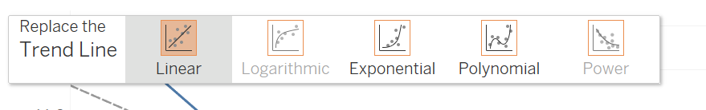
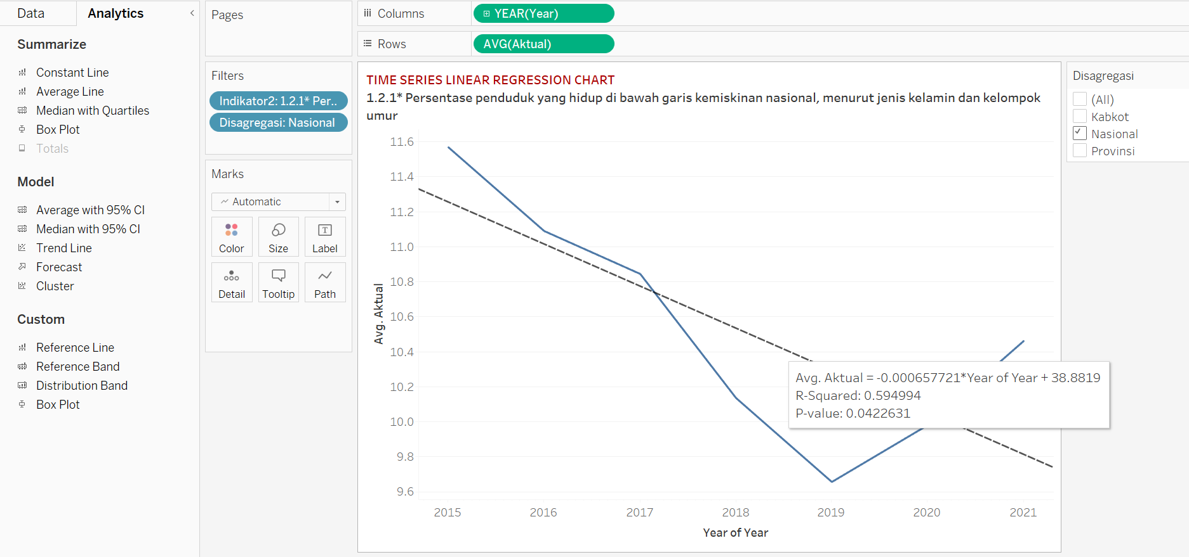
WORK 3 – LINEAR REGRESSION TIME SERIES

Slide 12
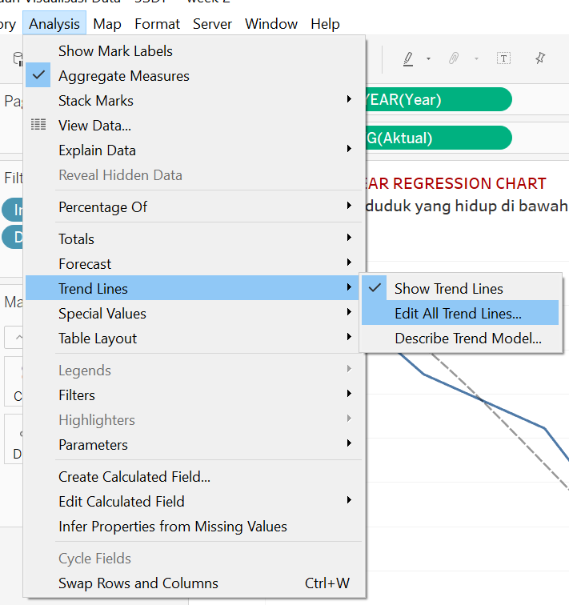
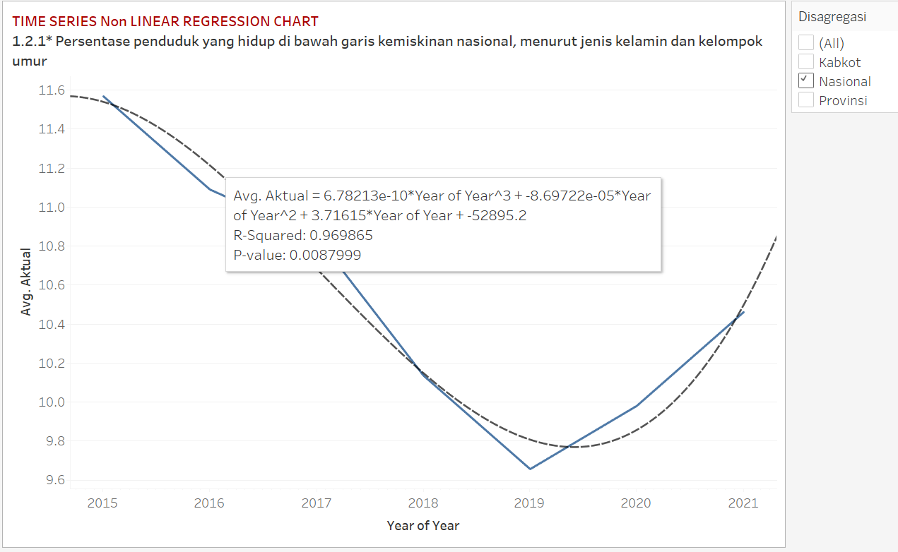
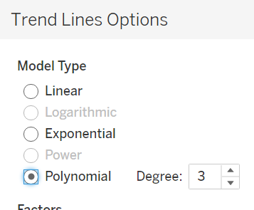
WORK 3 – LINEAR REGRESSION TIME SERIES

Slide 13
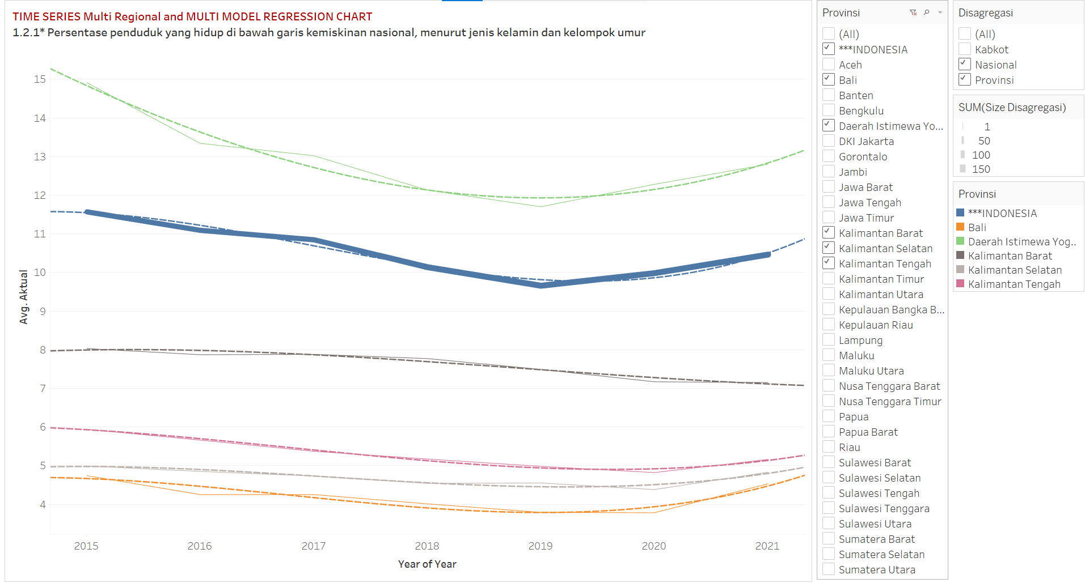
WORK 3 – Multi Regional LINEAR REGRESSION TIME SERIES: TEST

Slide 14
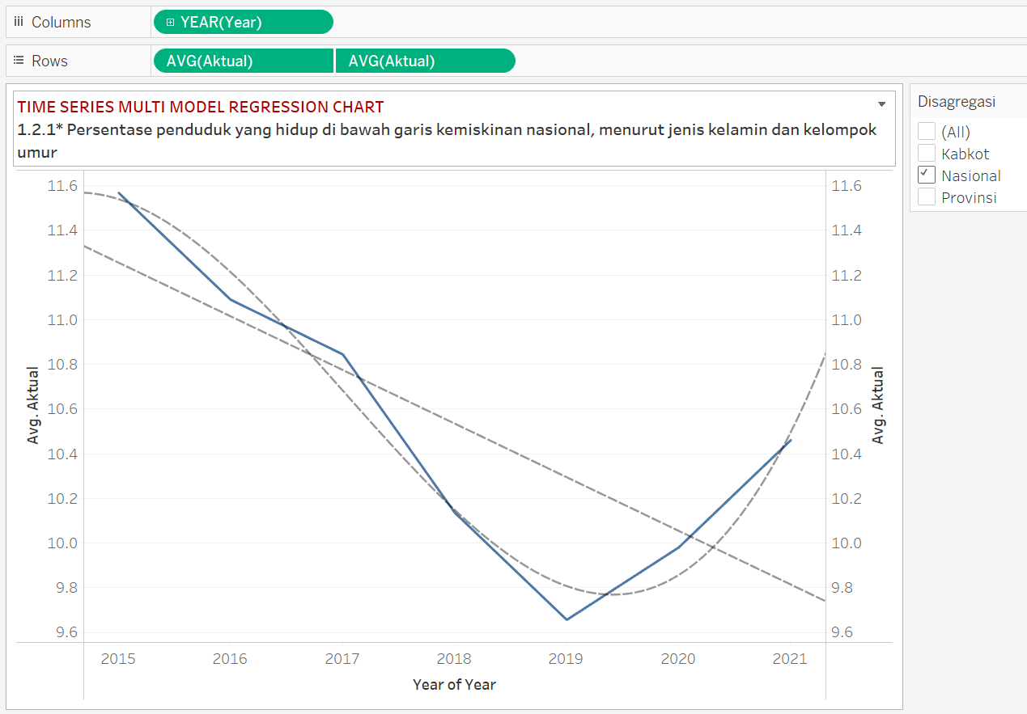
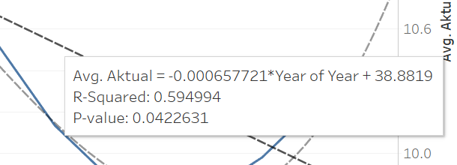
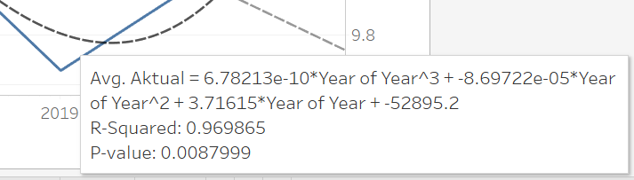
WORK 3 – LINEAR REGRESSION TIME SERIES: TEST
Which one is BETTER?

Slide 15
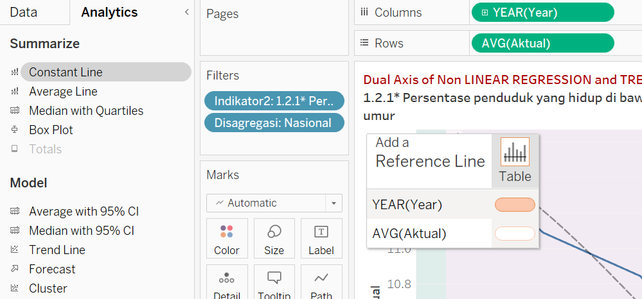
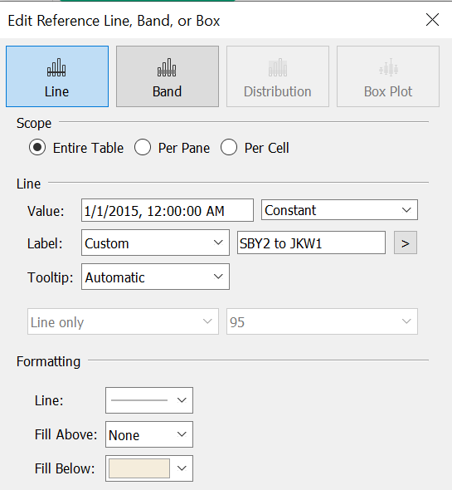
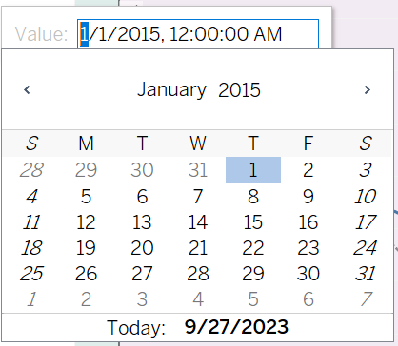
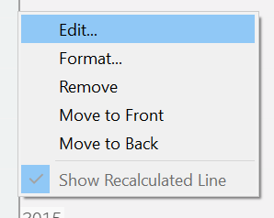
WORK 4 – COLORING BACKGROUND AREAS: From SBY to JKW
Edit the line
Edit the color

Slide 16
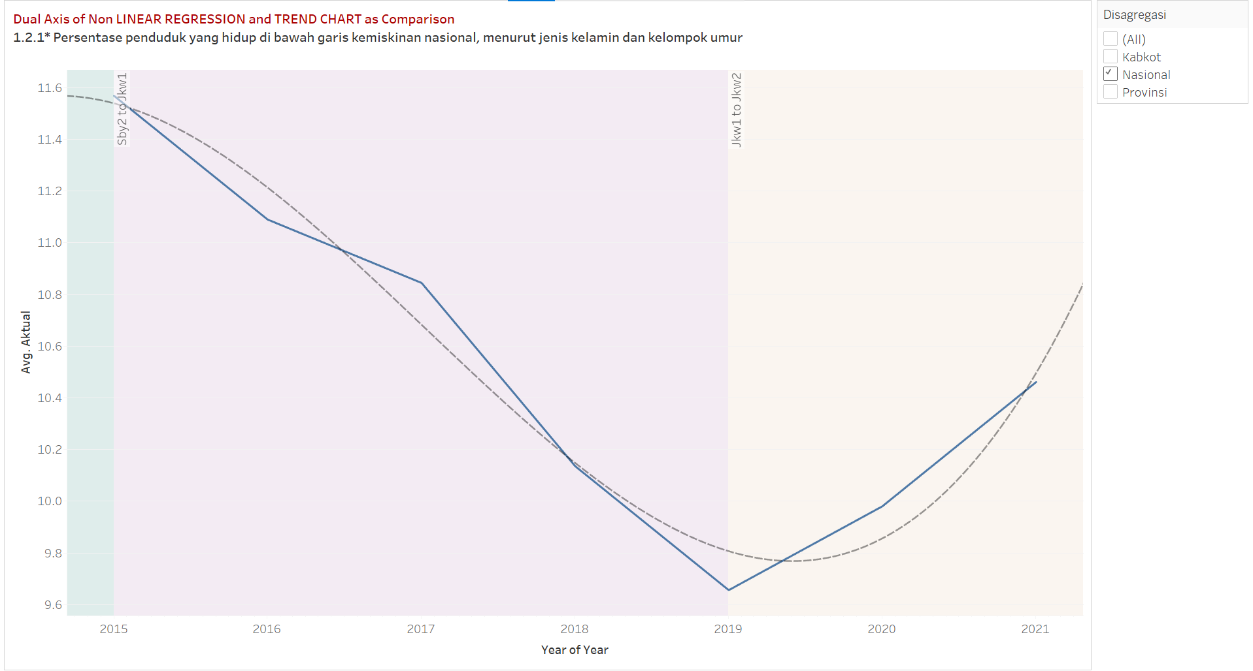
WORK 4 – COLORING BACKGROUND AREAS: From SBY to JKW

Slide 17
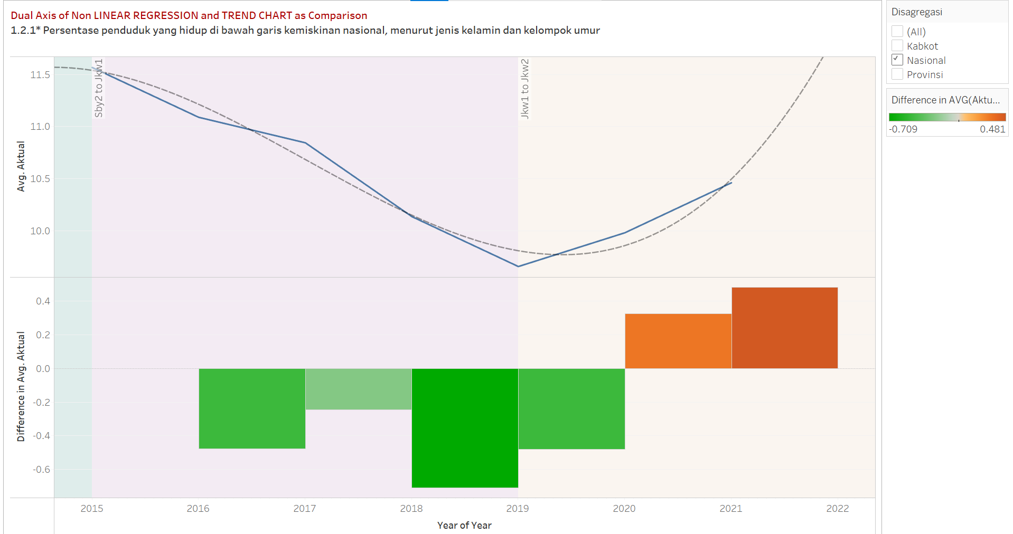
WORK 4 – COLORED TIME SERIES with TREND: TEST

Slide 18
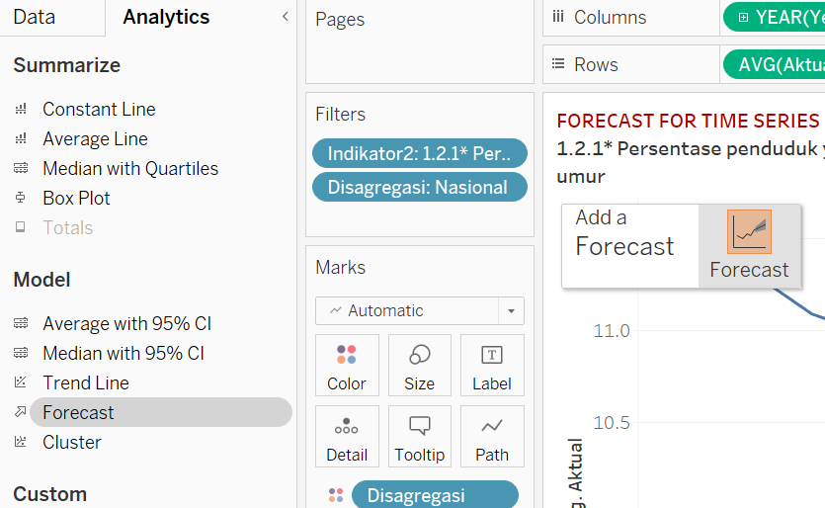
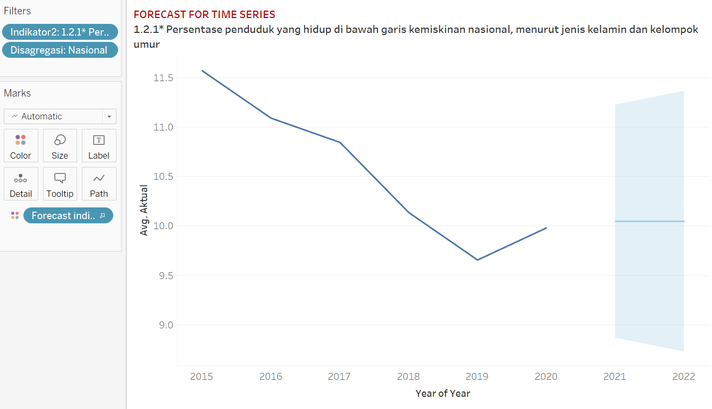
WORK 5 – FORECAST for TIME SERIES

Slide 19
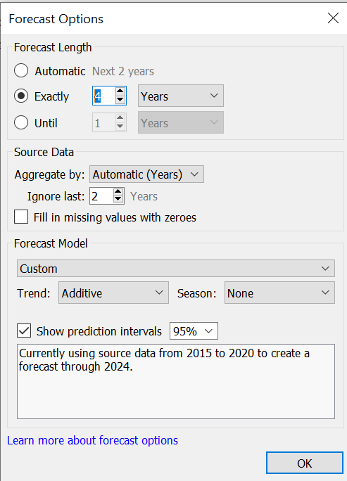
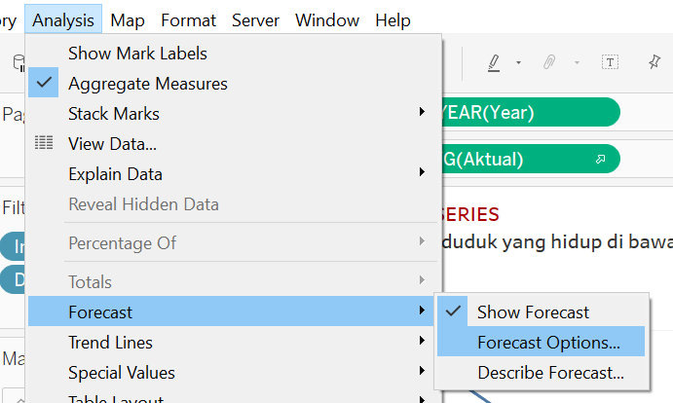
WORK 5 – FORECAST for TIME SERIES

Slide 20
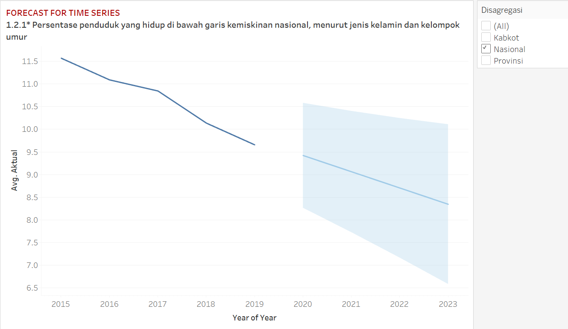
WORK 5 – FORECAST for TIME SERIES

Slide 21
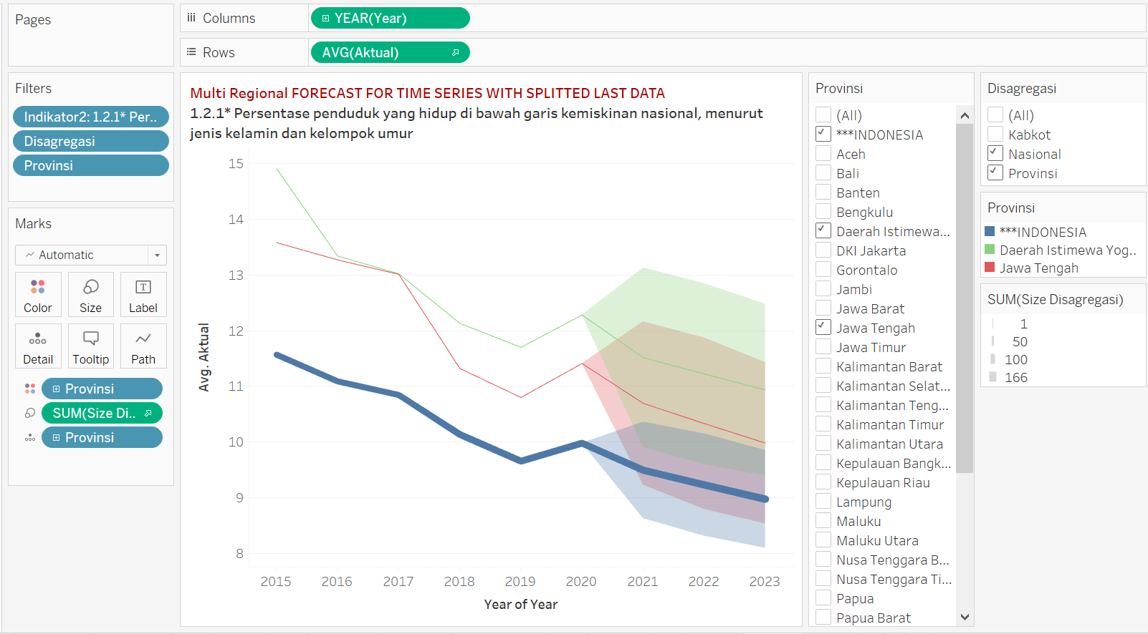
WORK 5 – Multi Regional FORECAST for TIME SERIES

Slide 22

TIME SERIES DASHBOARDS development

Slide 23
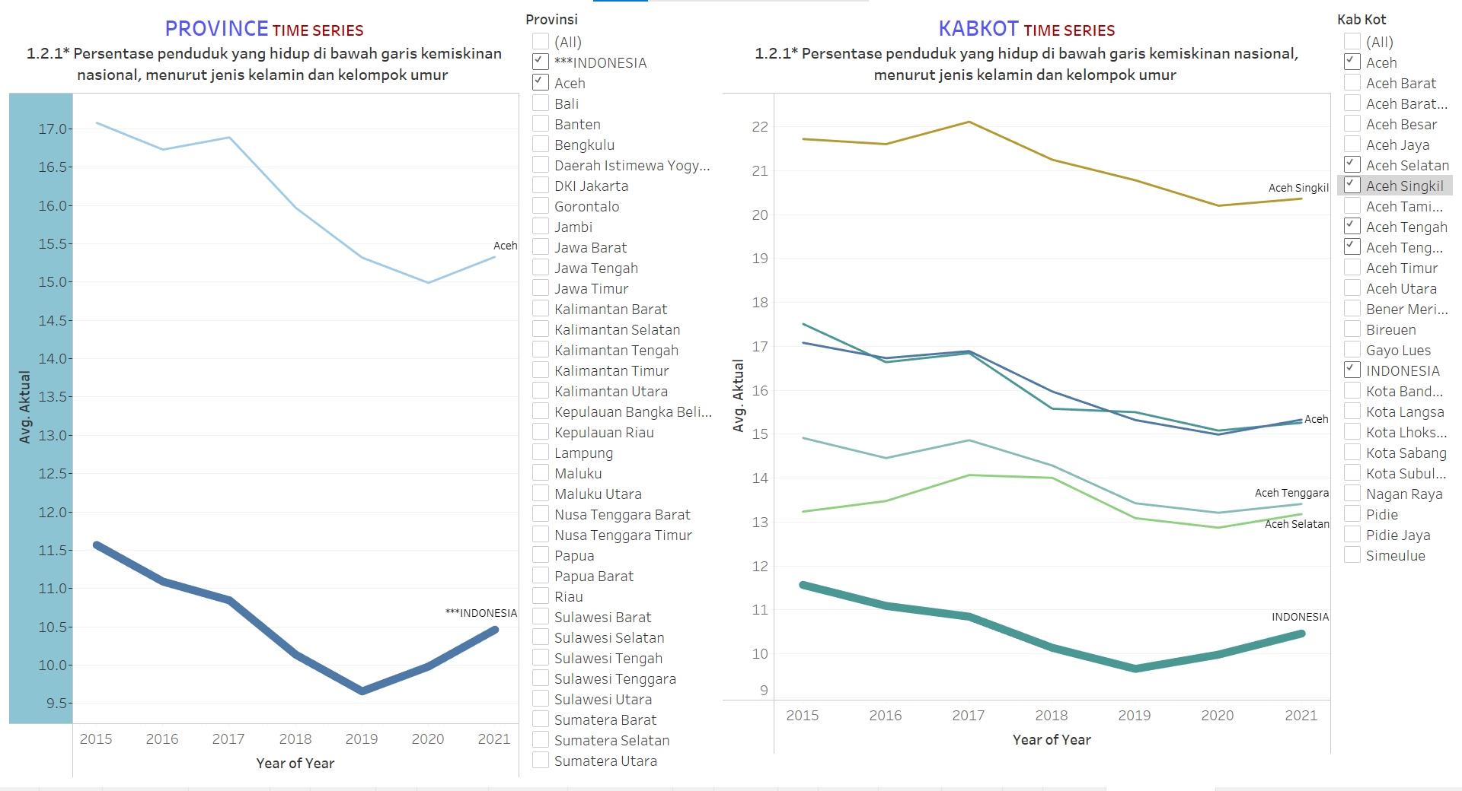
DASHBOARD: From Province to Kabkot

Slide 24

FURTHER EXPLORATION

Slide 25
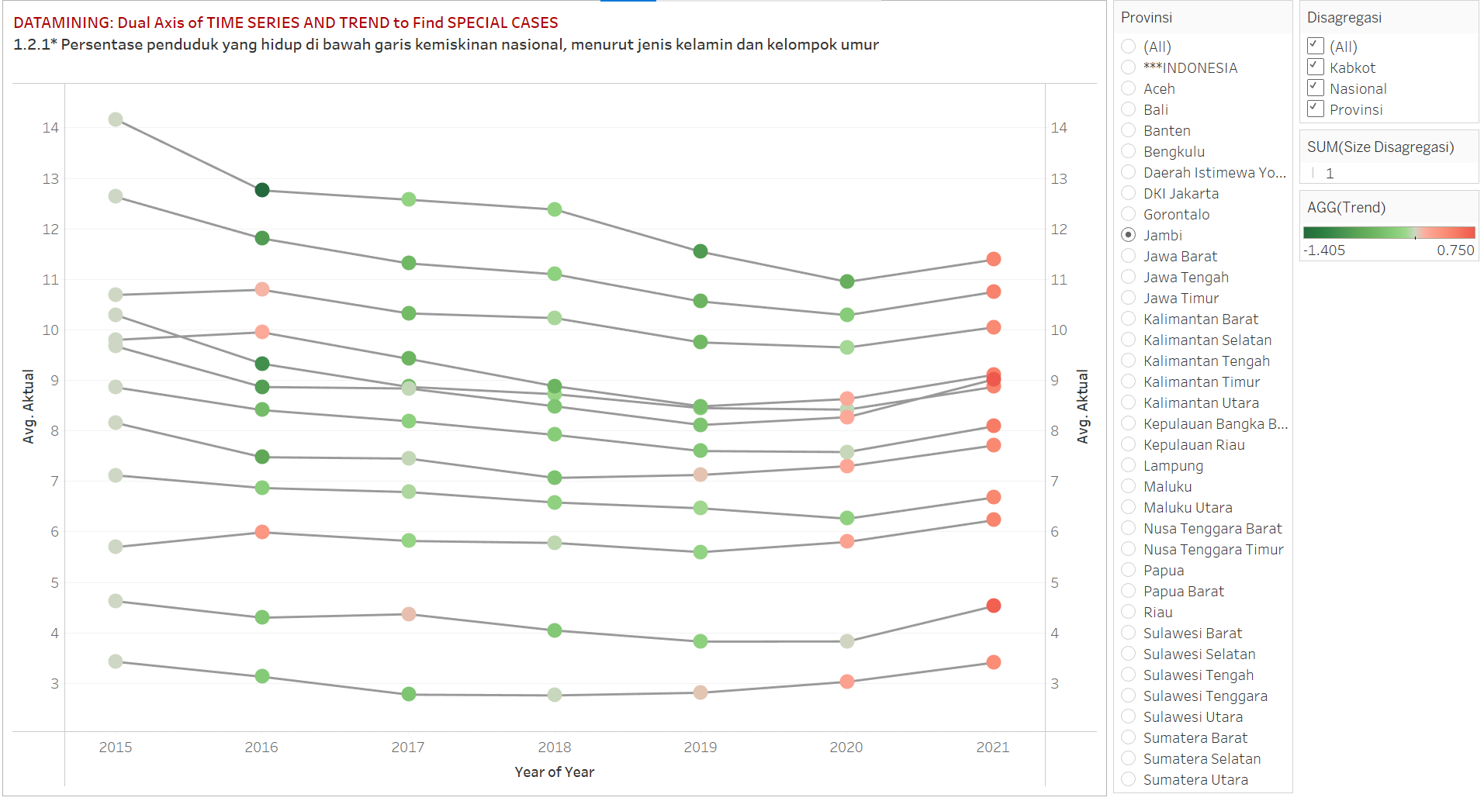
DataMining for TIME SERIES

Slide 26
Just a note for future work
Single time series – a simple one
Single time series with target
Single time series with colored background
Single time series with parallel graph of trend
Single time series with lookup
Single time series with linear regression
Single time series with forecast
Single time series dual X between forecast and linear regression
Single time series dual X with Pie-Chart
Multiple region time series – Prov & Kabkot for dashboard
Multiple region time series – Prov for regression analysis
Time series for CMRS

